Slide 1
Radicalisation Awareness Network
Maarten van de Donk
NAVT Conference, The Hague November 5th

Slide 2
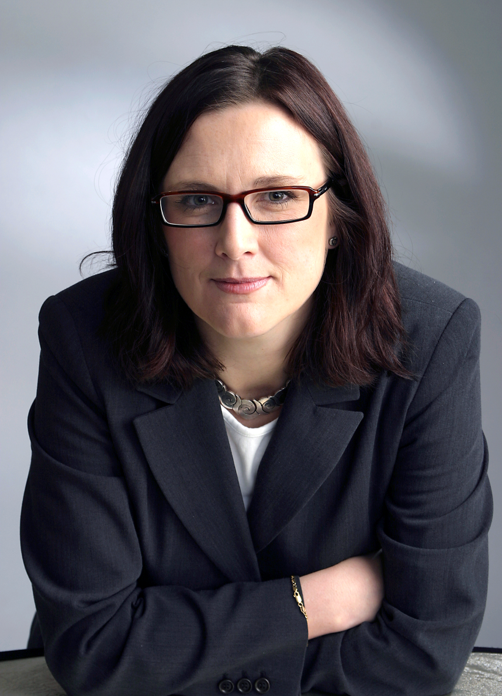
Where it comes from
European Commission
DG Home
Commissioner Cecilia Malmström

Slide 3
Goal
Prevention
RADICALISATION
Deradicalisation

Slide 4
What is the Radicalisation Awareness Network?
Connecting people who work on radicalisation on the grassroots level.
Network of networks: 8 working groups dealing with a subject or representing a profession/group.
Steering committee consisting of European Commission and chairmen Working Groups
Secretariat
2012-2016

Slide 5
What are the main deliverables?
Strengthening position of field workers by exchange of knowledge, good practices.
Giving policy advice to decision makers on European and national level.

Slide 6
Working Groups I
Voices of Victims of
Terrorism
Derad
Internet
Health

Slide 7
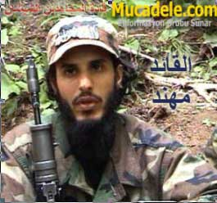
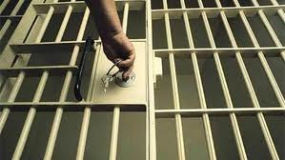
Working Groups 2
Int/Ext
Police
Prison & Probation
Prevention

Slide 8
RAN Voices of Victims of Terrorism
Focus on narratives of Victims in the process of preventing people getting involved in violent radicalisation or in the process of getting them out.

Slide 9
State of Play
All working groups have started their activities
Upcoming: High level meeting (commissioner and ministers of member states) in January 2013
Website will be launched soon

